Slide 1


Slide 3



Hello!
I am Racim RIGHI
https://linkedin.com/in/racim-righi/
racim458@gmail.com
https://github.com/RacimRgh/
<number>

Slide 4
Lets start with some theory !
I promise it wont be long.
<number>

Slide 5

“I really never wanted to do source control management at all and felt that it was just about the least interesting thing in the computing world” -Linus Torvalds
<number>

Slide 6
Source control management
Also refered to as Version Control Management, it allows us to:
Revert files or an entire project to previous states without losing progress
Compare changes over time
See who last modified something
Remote work
Collaborate with your team or people around the world
And way more that we’ll see later on
<number>

Slide 7





Version control management
Centralised
Distributed
DATABASE
PC
REPOSITORY
PC1
Version 1
File.txt
File.txt
Version 3
Version 2
Version 3
PC2
Version 3
Version 2
Version 2
File.txt
Version 4
Version 1
Version 1
7

Slide 8
Yeah, but why would I use that?
Lets talk about maths
Let’s imagine you’re solving a long math equation
In the end you realise you got the wrong result
What do you do?
Erase and start all over
Cross out until the point where you were correct
7

Slide 9
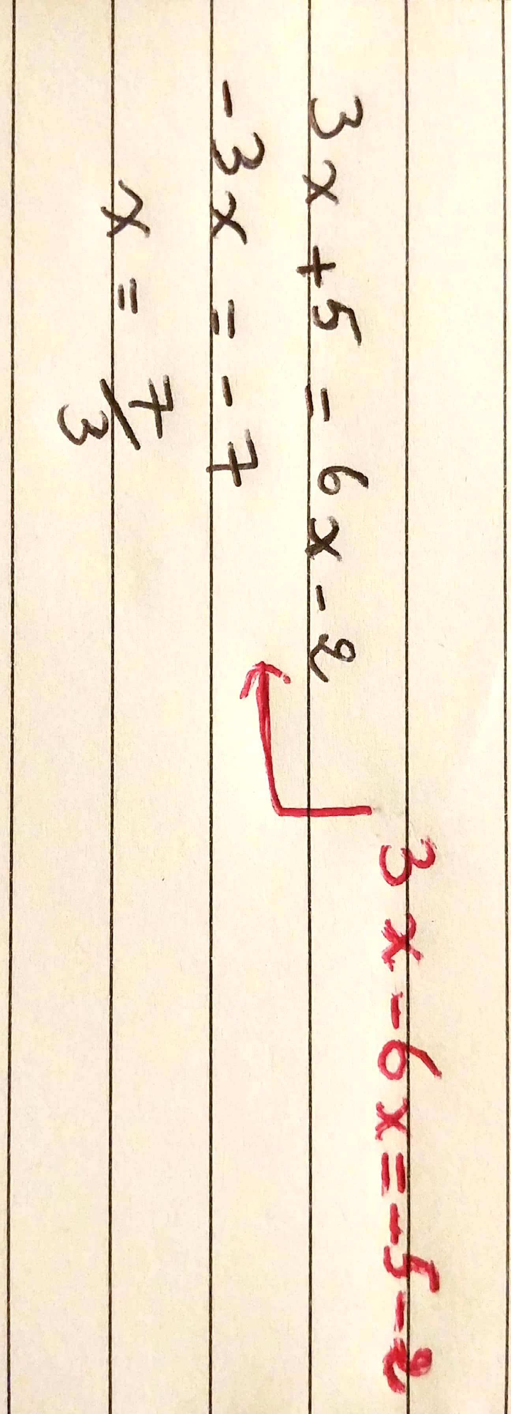
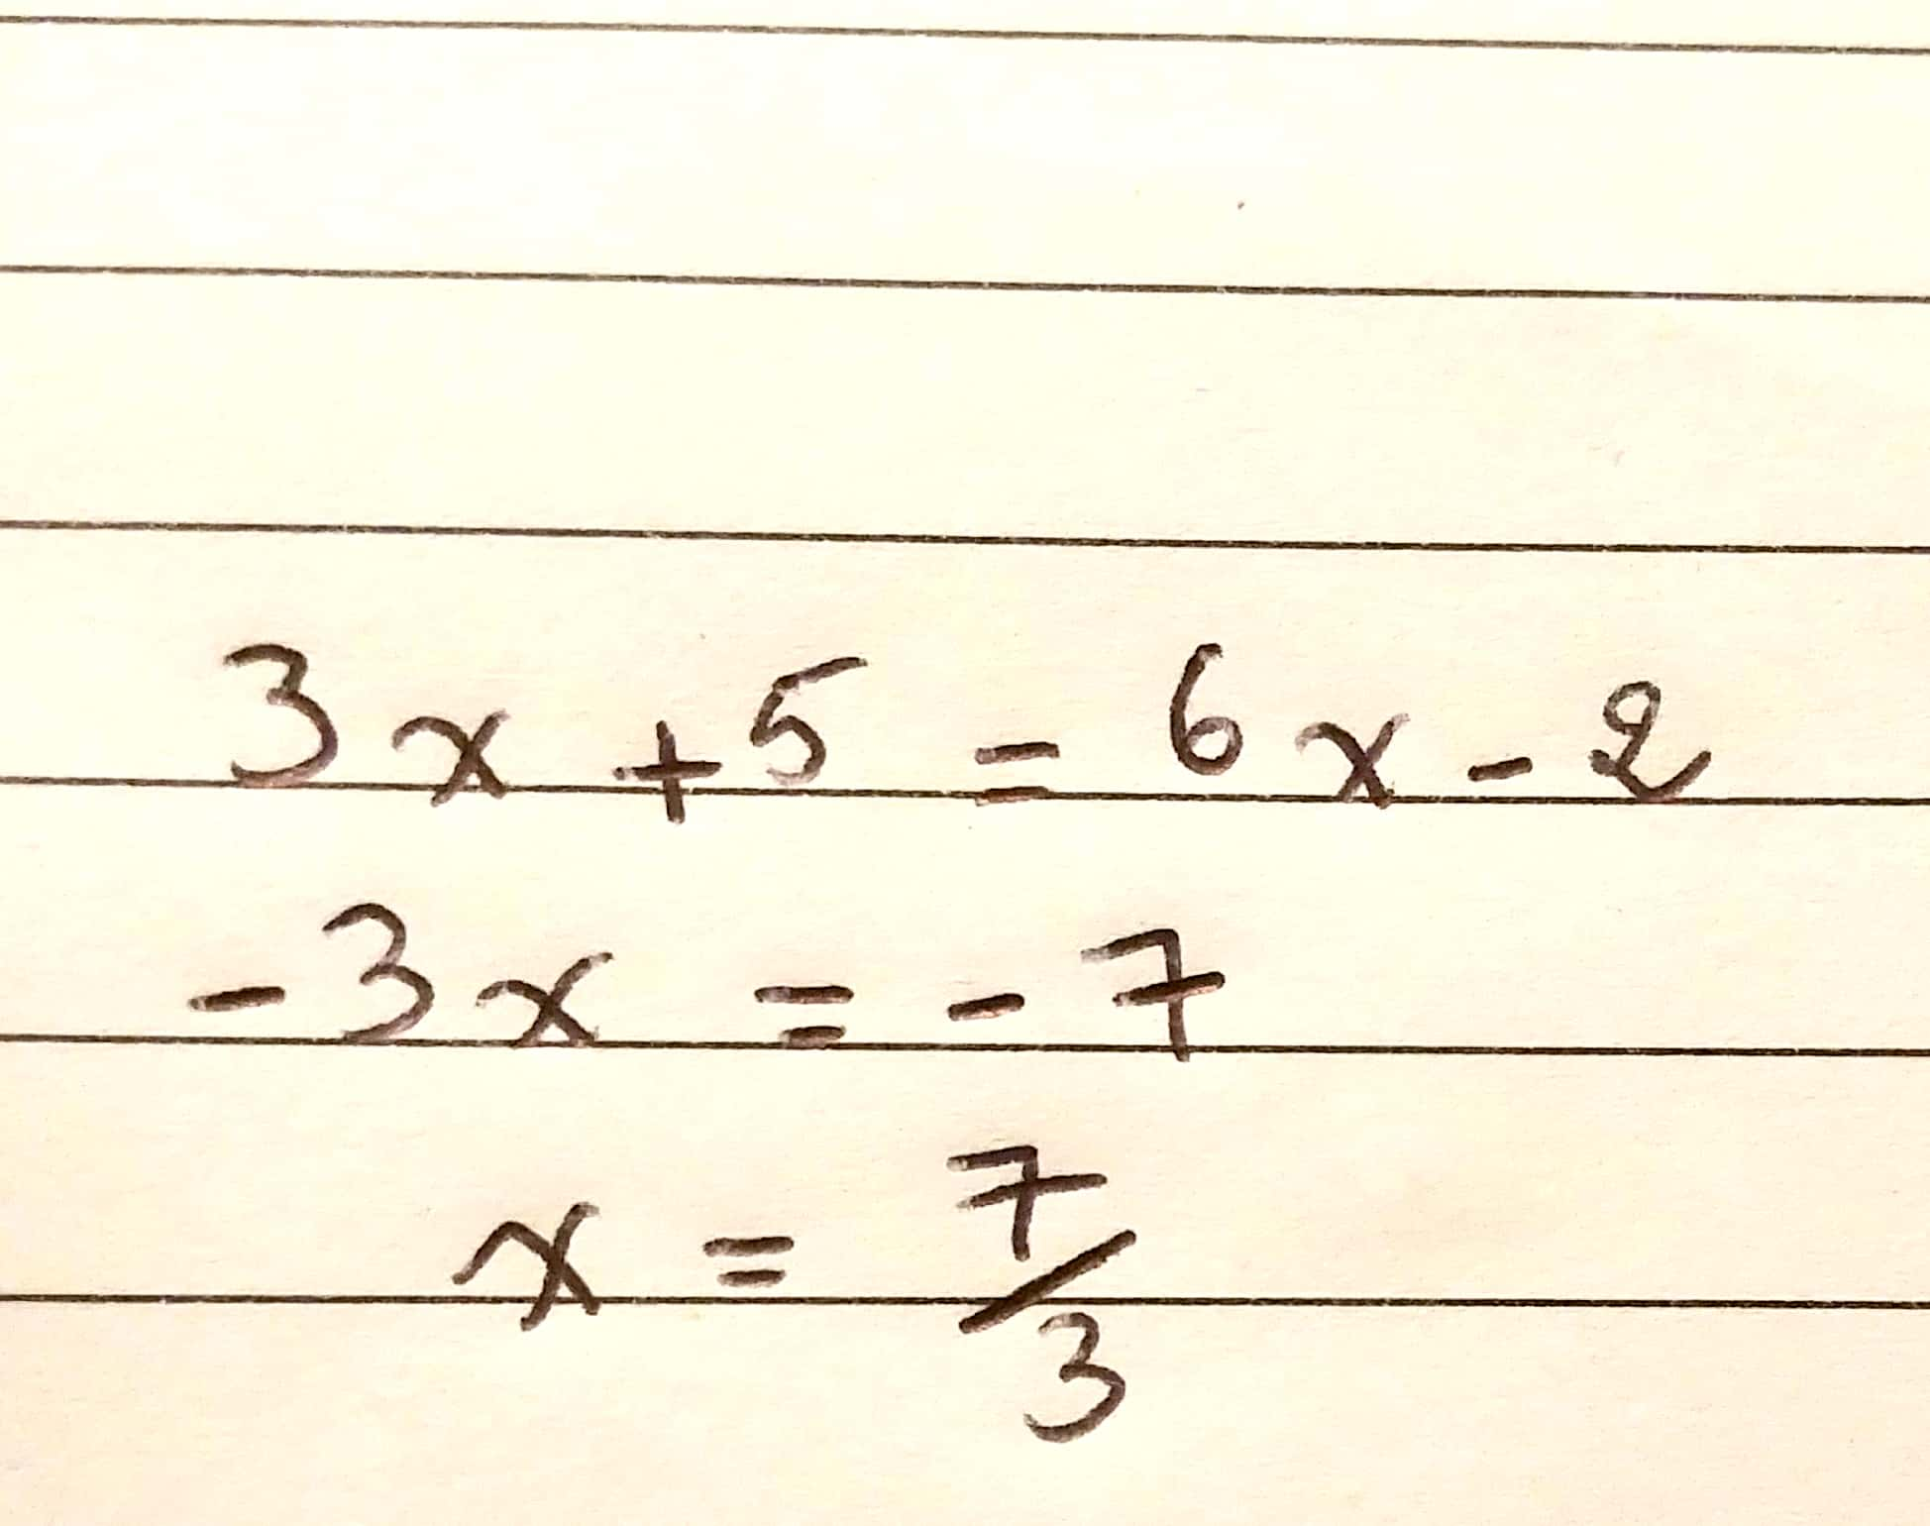
You’re working on an equation
Your teacher tells you you need to mention every step
Its gonna get messy the longer it gets
7

Slide 10
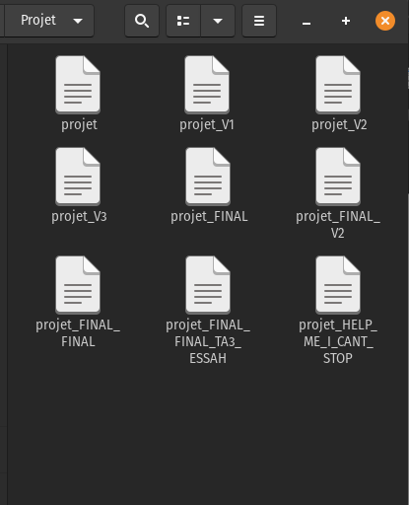
Every project ever...
Disadvantages:
- Locally only
- No metadata
- No history
- Too heavy on resources
- Difficulty of collaboration
7
7

Slide 11


Slide 12


GIT
The most popular VCS
7

Slide 13
What’s GIT?
Git is a mature, actively maintained open source project originally developed in 2005 by Linus Torvalds.
Secure
Fast and reliable
Flexible: Efficient in small and large projects, compatible with a large set of operating systems and IDE’S.
7

Slide 14
How to install
Windows
Download: https://git-scm.com/download/win
Linux
Verify if it is already installed with your OS with
$ git –-version
if not use
$ sudo apt install git
Mac OS
Download: https://git-scm.com/download/mac
7

Slide 15

LOCAL
REMOTE
Git
add
Git commit
Git push
Working directory
STAGING AREA
Local repository
Git pull

Slide 16
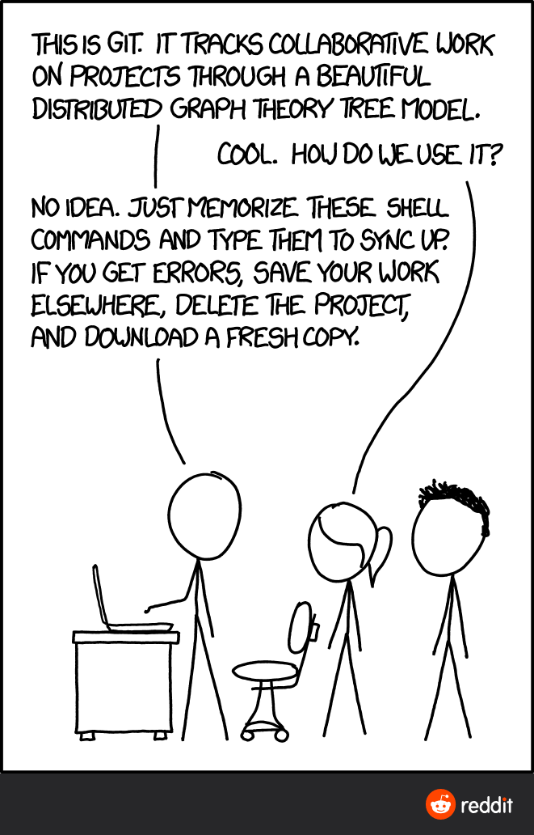
0
But how do i do that?
Just wait a little more...
Here’s a little distraction to help you wait

Slide 17
GITHUB
The web service for hosting projects
7

Slide 18
What’s GITHUB?
Github is a website that provides hosting for software developement projects and version control using Git. It offers the same set of functionnalities as Git, plus a lot of its own features.
Create an account at
- https://github.com/
7

Slide 19
Get used to some terms!
Repository: Each project is stored inside a repository
Commit: A snapshot of the project
Pull requests: A method of submitting contributions to a project.
README.MD: Each project inside a repository will have this file, it contains a description of the project and how to properly use it. It is written using markdown, a language for formatting text.
Learn more at: https://guides.github.com/features/mastering-markdown/
7

Slide 20
Let’s take a look at the interface
Don’t worry, you’ll get used to it with time.
7

Slide 21
For the more curious or/and advanced
Github is usable from the command line since September !
Visit this website for more info:
https://cli.github.com/
7

Slide 22
Let’s start the fun part !
We’ll take a look at some git commands
7

Slide 23
Configuration
Open a GIT command line and type:
$ git config –global user.name “RacimRgh”
$ git config –global user.email “racim458@gmail.com”
7

Slide 24
Remember this diagram?
LOCAL
REMOTE
Git
add
Git commit
Git push
Working directory
STAGING AREA
Local repository
Git pull
Let’s set it up in our machines
7

Slide 25

Git add
$ git add .
Allows you to add changes made on all the files across the repo
$ git add <filename>
Allow you to add changes made in a specific file
Git commit
$ git commit -m “a message that describes the changes made”
- The message has to be as brief and precise as possible

Slide 26

Starting a new repository and pushing it to github
Create a folder with your project’s name, and a repository on github with the same name then:
$ git init
- Add, modify and remove files
$ git add .
$ git commit -m “first commit”
$ git branch -M main
$ git remote add origin <repo_url>
$ git push -u origin master

Slide 27
Cloning an existing repository
- To get the url, go to the project’s repo in github
- Click on the green button “Code”
- Copy and paste the HTTPS link
$ git clone <repo_url>
7

Slide 28
Let’s make our first pull request
Only 3 will remain to get those sweet prizes!

Slide 29
Step by step guide to a pull request
Fork the repository
Clone the forked repository (from your profile)
Make useful changes
Git add and commit your changes with an undestandable and explicit commit message
Push the changes to the forked repo
Make the pull request
Wait for the maintainers to review your PR
???
Profit !

Slide 30



Congratulations !!!
You made your first pull request !
If you have a question, feel free to ask

Slide 31




Don’t forget to follow us on social media !
@openmindsclub
@Open Minds Club
@openmindsclub
@clubopenminds
7

Slide 32





Presented by

